Slide 1
Semi conductor – chip shortage Analysis
DSE203 – Data integration and ETL project
- Brij dwivedi, chunxia tong, Solaimalai subramanian

Slide 2



Introduction
Collect news around ‘chip shortage’, ‘CHIPS & Science ACT’ and ‘global supply chain crisis’ under semiconductor industry.
GOAL:
Top 5 names around this topic and understand their relationship with chip shortage & supply chain crisis
What were various acquisition occurred between Y2020 - Y2021 in semiconductor industry?
How COVID-19 affected semiconductor industries ?

Slide 3

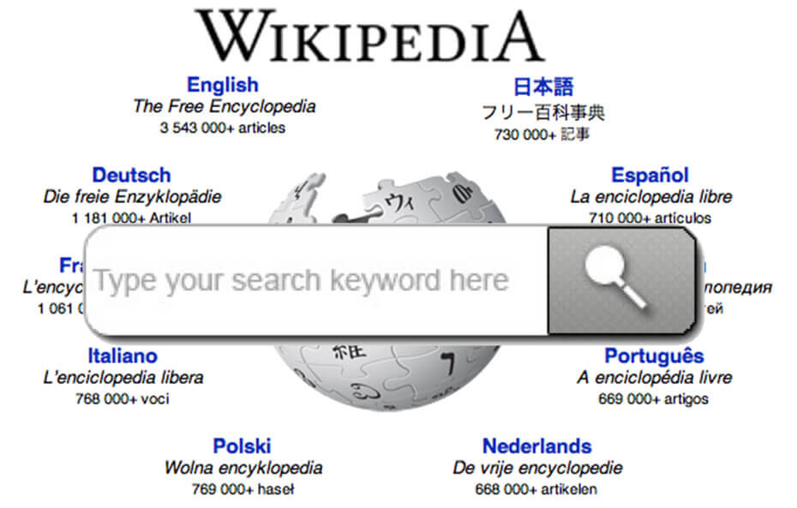
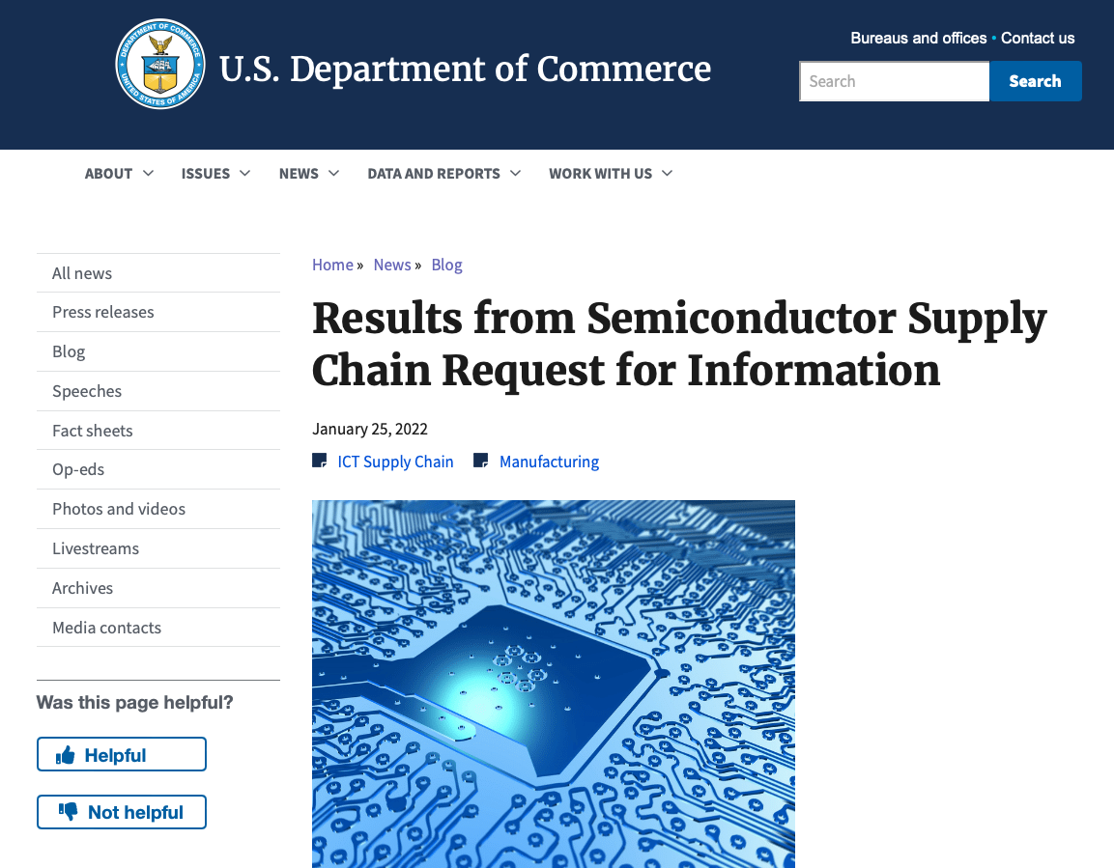
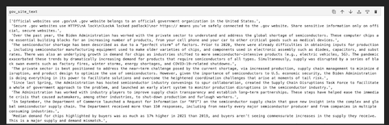
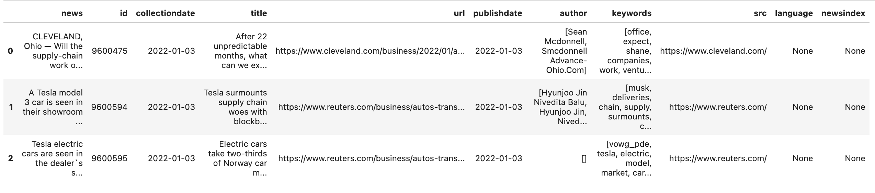
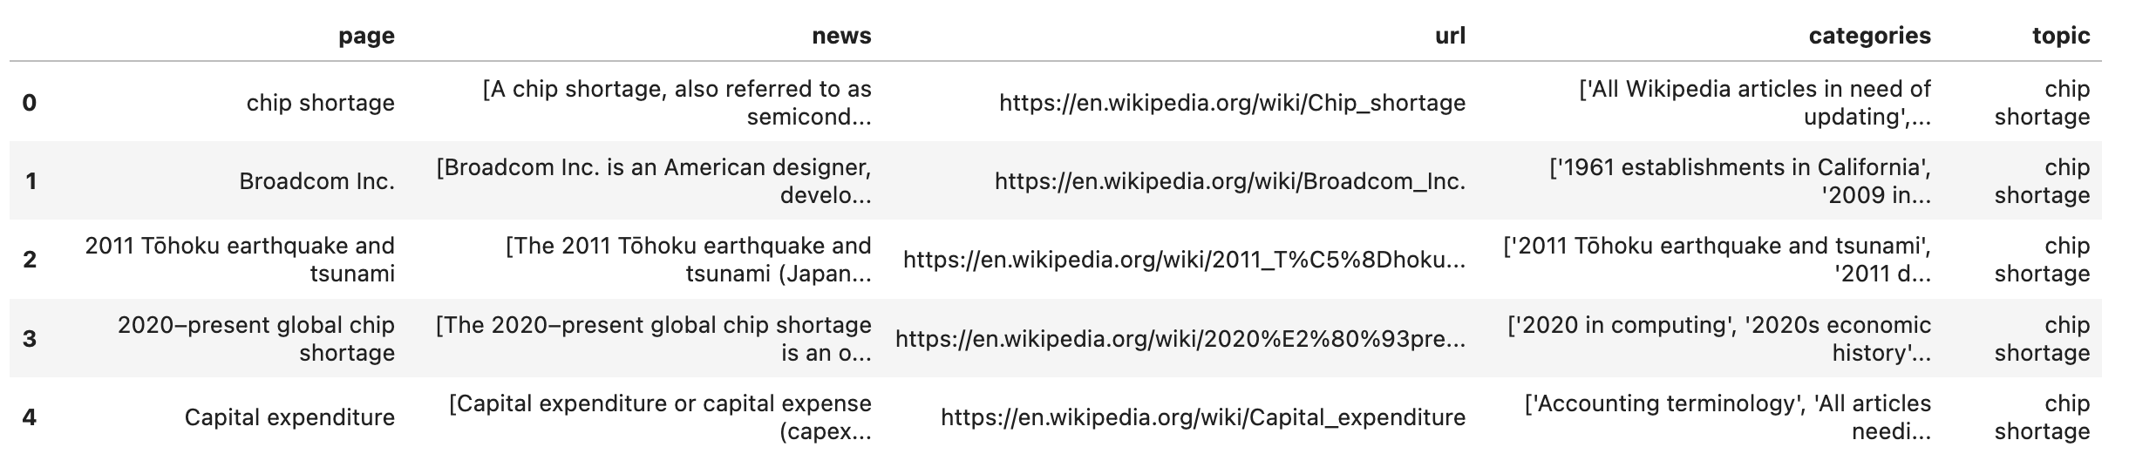
Data Source
Data Source | Number of rows | Data Type
News Data set | ~10K ( news web pages) | Structured data
Wiki pages | 375 (wiki web pages) | Unstructured
Government site | 1 web page | Unstructured
Extract the texts from government website related to “chip shortage, semi conductor”
Extract the News with keyword “chip shortage, semi conductor” from us news data set
Extract the entire page texts for pages returned for wiki search “chip shortage, semi conductor”

Slide 4
Methodology
Neo4j Demo
neo4j Data Preparation
NLP Using Spacy
Pre-process the Data
Data Cleaning
Subject-Verb-Object Extraction

Slide 5
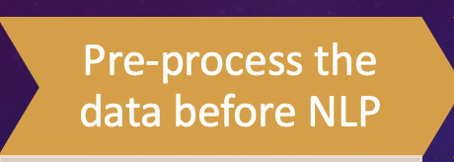
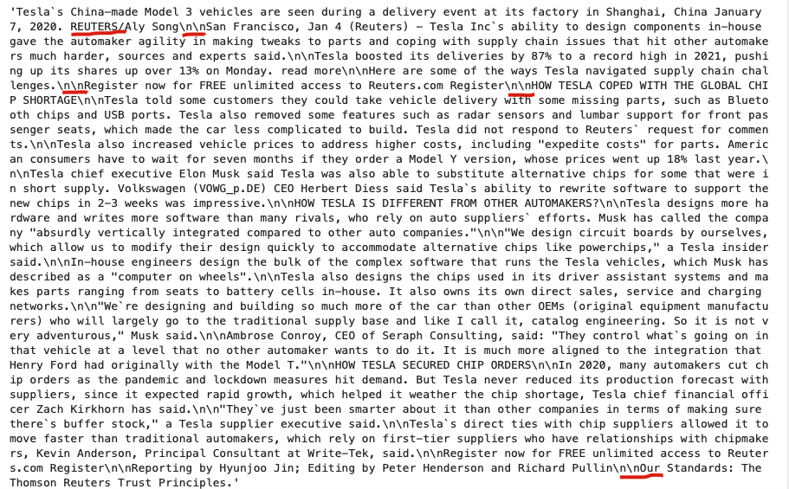
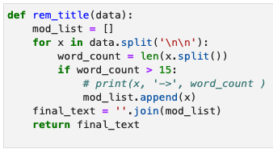
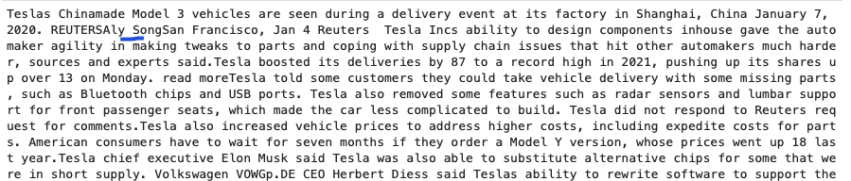
Preprocess data - NEWS
Remove title from news data → Title being initial string was affecting coreference resolution
Remove special character like \n\n & ()
Lower all the character after performing subject-verb-object extraction

Slide 6
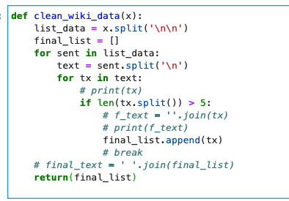
Preprocess data - WIKI
Remove title from wiki data → Title being initial string was affecting coreference resolution
Remove special character like \n\n & ()
Remove sentences having less than 5 words.

Slide 7
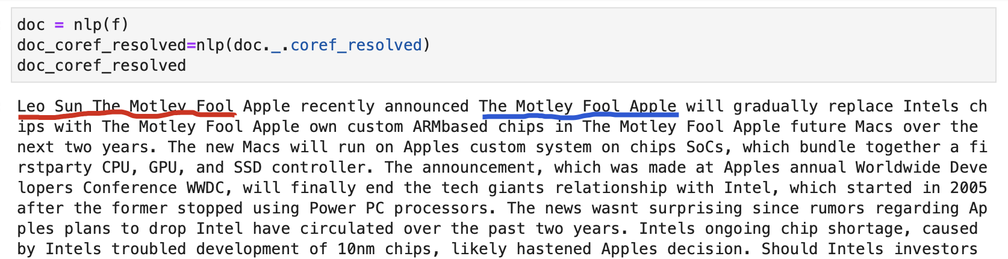
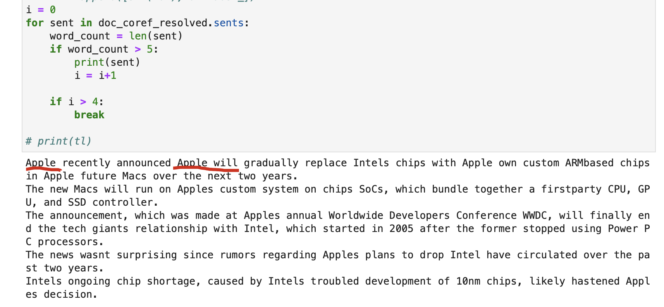
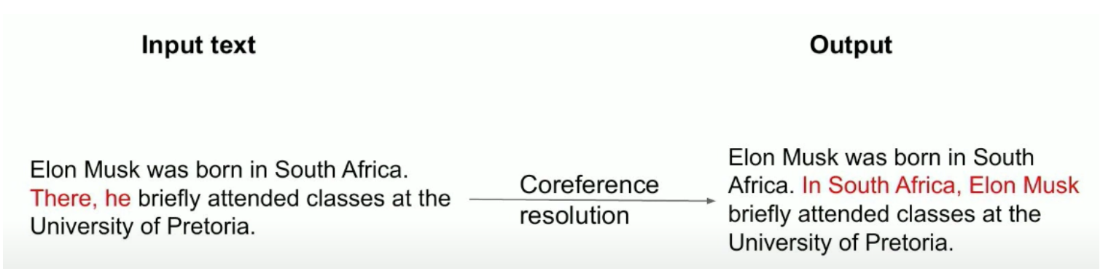
NLP – Coreference resolution
finds all expressions that refer to the same entity in a text. It finds all the pronouns and then replaces those with their reference entities. Pronouns can be personal, location, or possessive

Slide 8
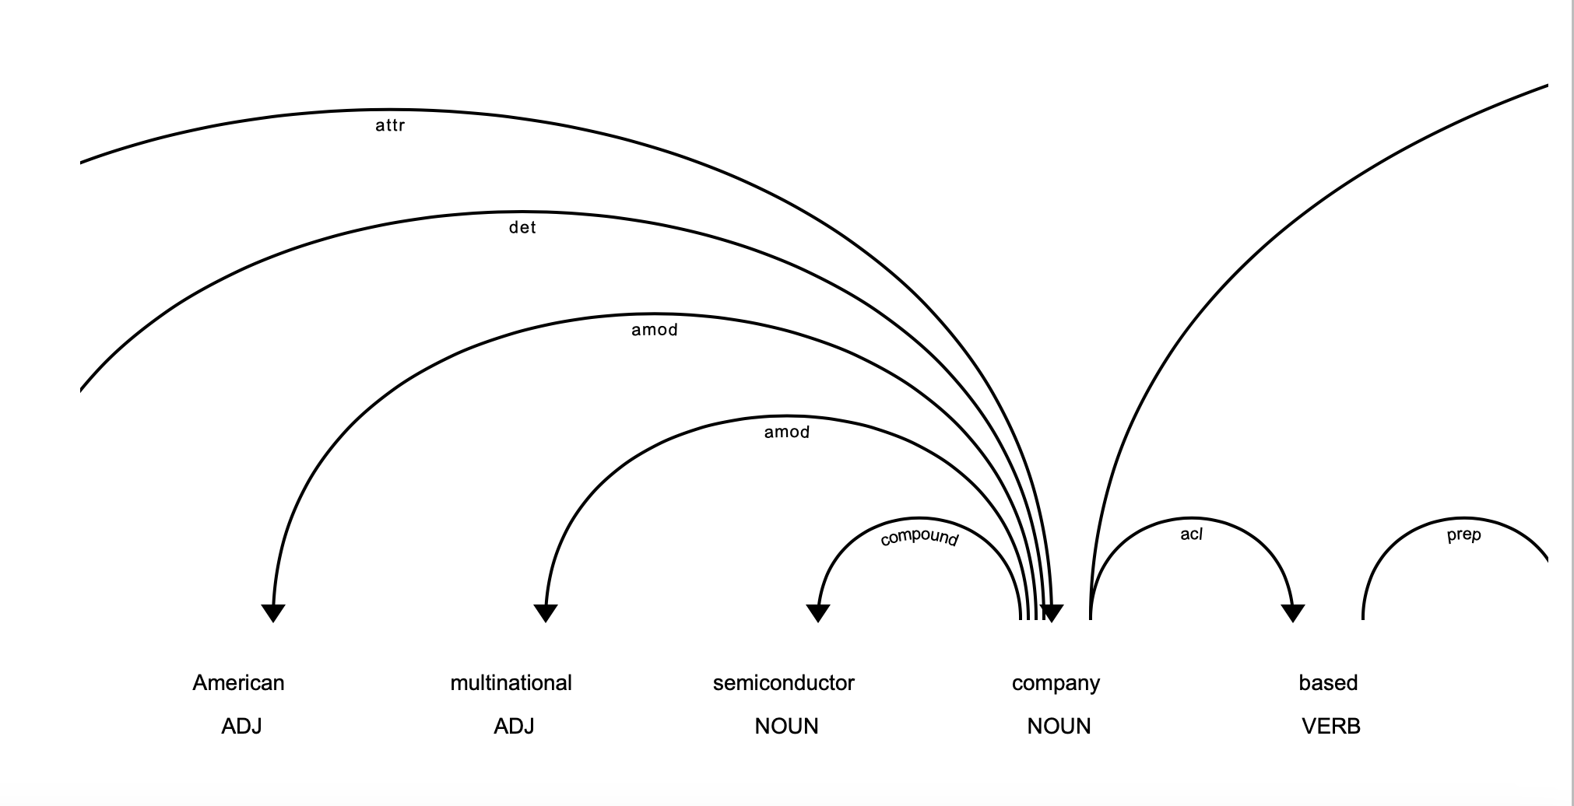
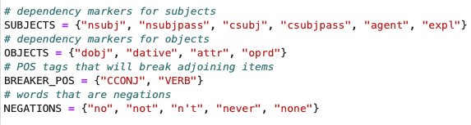
NLP – Relationship extraction
Extracted subject – verb – object triplet
Rule based extraction where each sentence was analyzed to extract subject verb and object

Slide 9
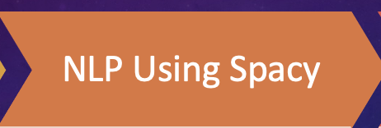
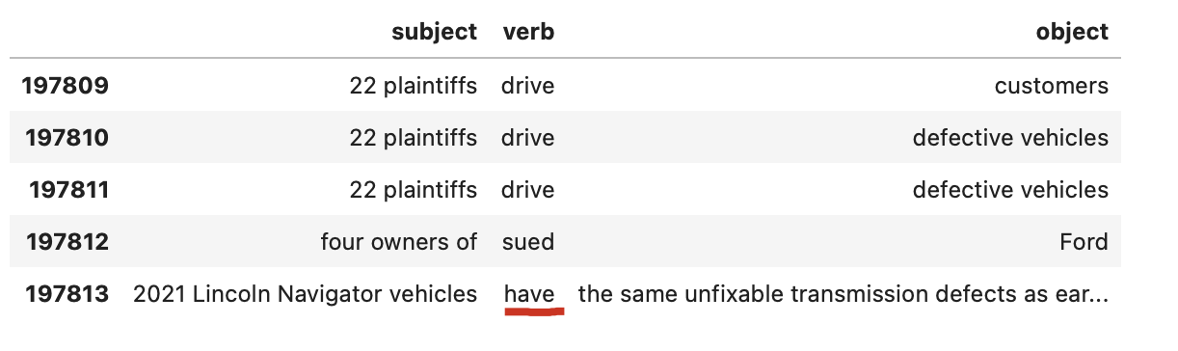
NLP
Identify the Subject Verb Object triplet
Identify Token & Entity to create node csv
Lemmatize the verb, remove stopwords and identify synonyms using Wordnet
Find the similarity for Subject and Object using Jaccard Similarity with threshold 0.5
Filter the entries that have subject and object are same
Filtered subject & object having less than 3 characters
Removed numerical & alpha numerical values from subject & object [e.g. A234, XYZ456]

Slide 10
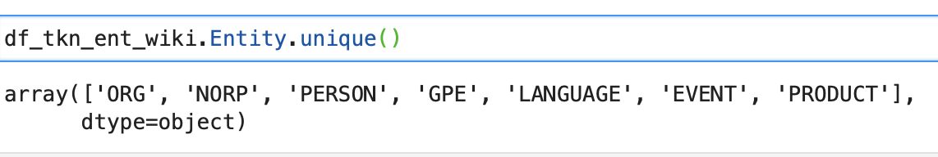
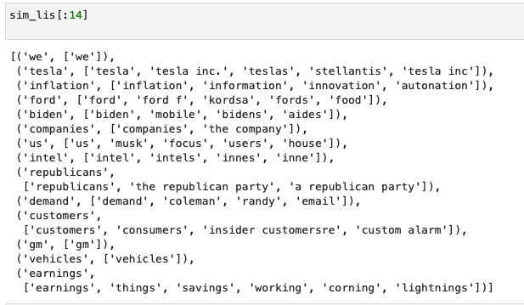
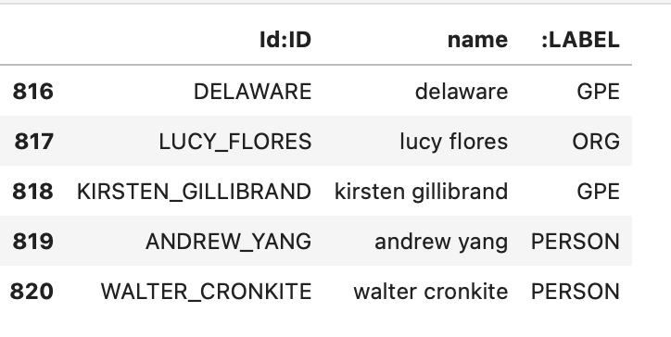
NLP – Entity Selection & Synonyms
Identified named entity with the help of NLP library

Slide 11
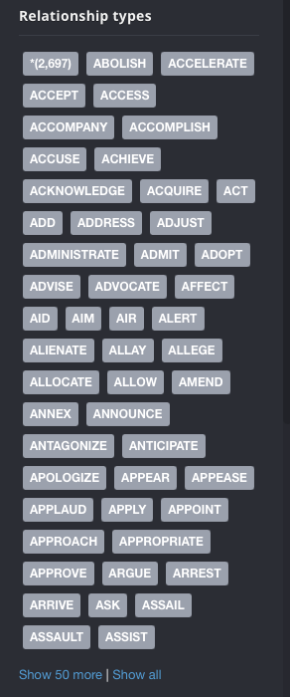
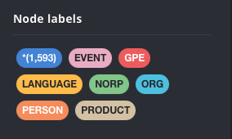
NEo4j - Summary
Node – 1593
DISTINCT NODE - 7
Relationship - 2697

Slide 12
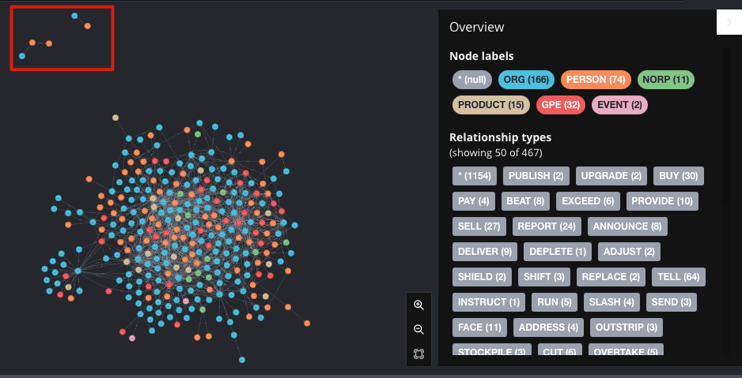
Neo4j – ALL Data
Some of the nodes have only one relationships and they are not connected with multiple other nodes.

Slide 13
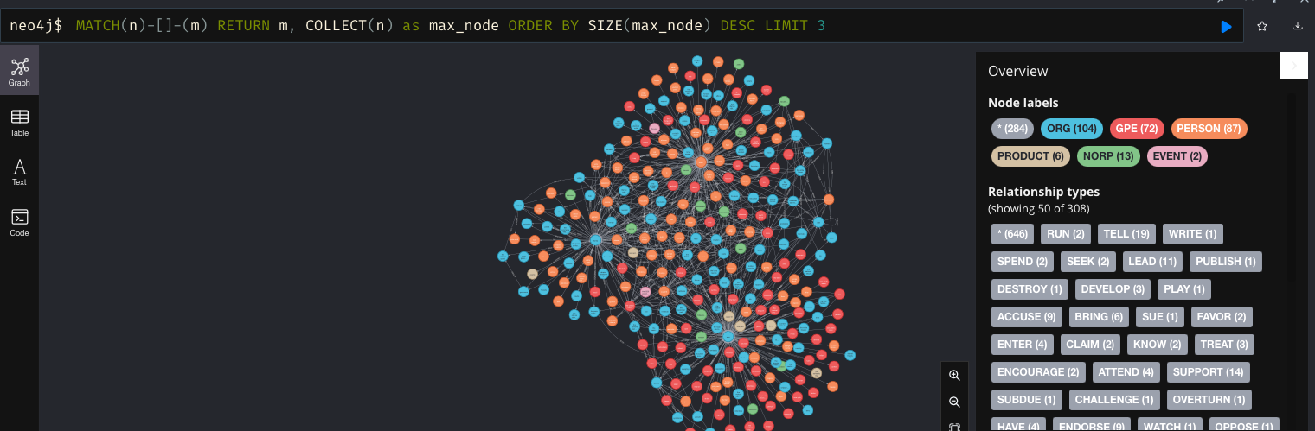
Neo4j – Top5
What was top 5 quoted name in Year 2020-2021 news around semiconductor news ?
WHO – World Health Organization
COVID19
BIDEN – US President
TRUMP – Former US President
China
Consumer

Slide 14
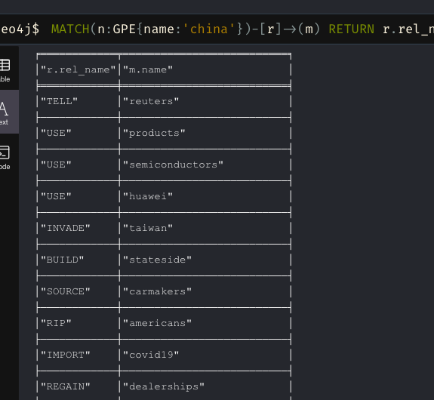
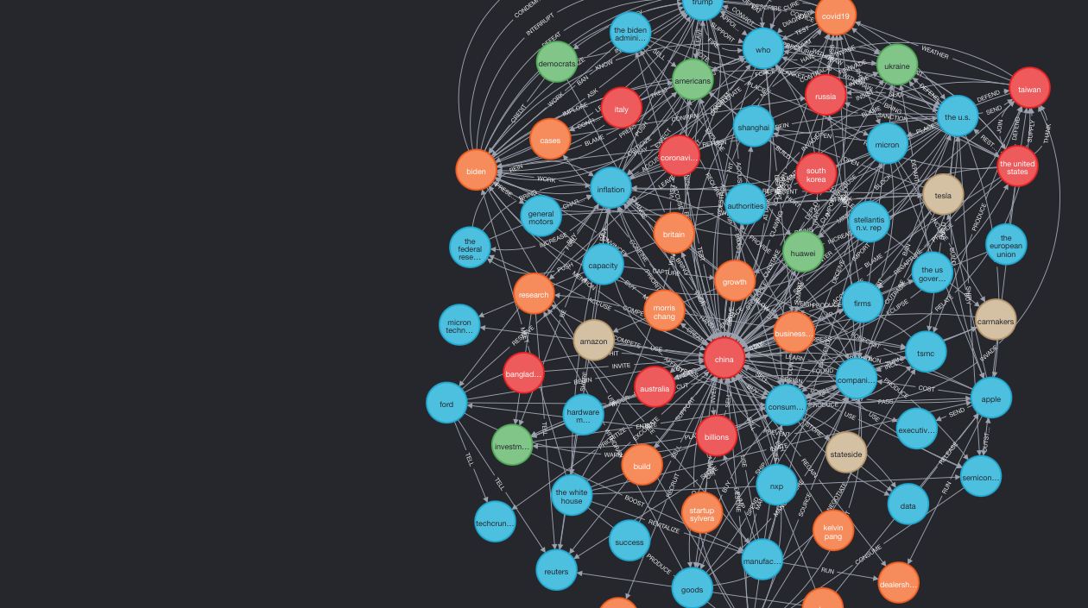
Neo4j – Semiconductor Hub
China’s role in semiconductor industry

Slide 15
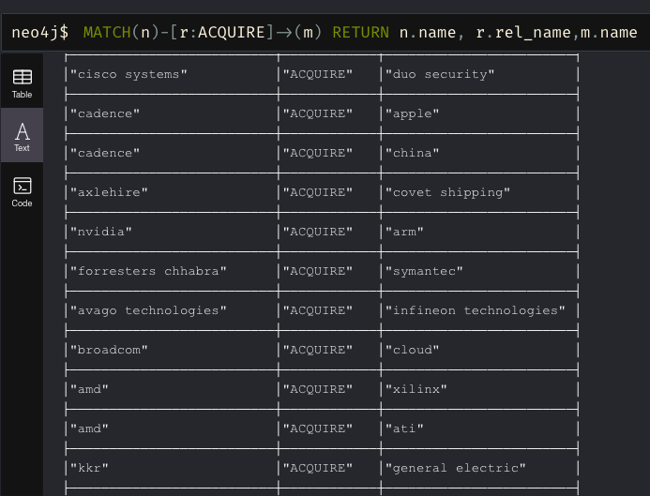
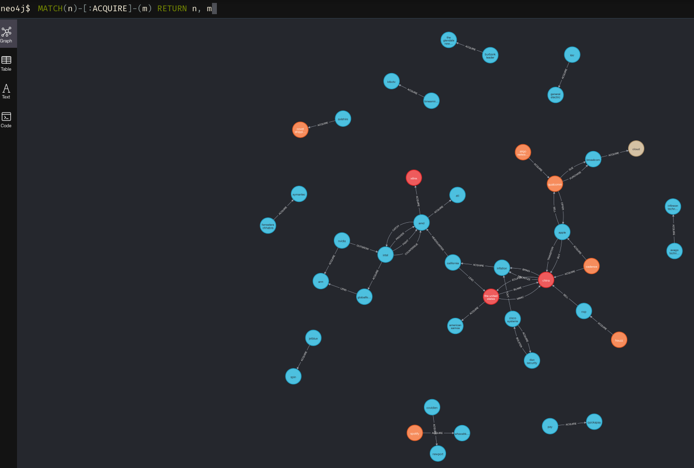
Neo4j - Acquisition
Which organization Acquired other organization or entity ?

Slide 16
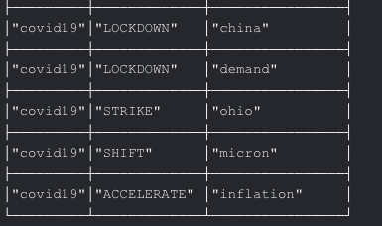
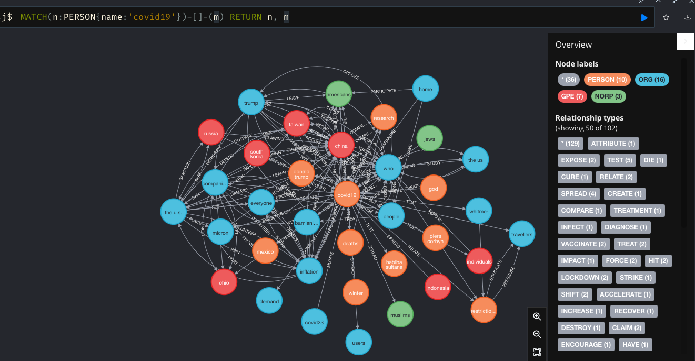
Neo4j – COVID19 impact on semiconductor
How covid-19 affected semiconductor industries ?

Slide 17
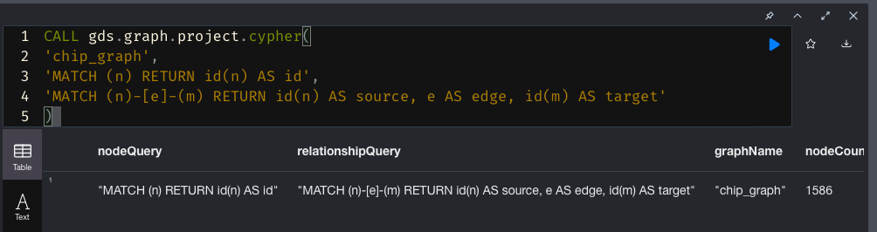
Gds – creation
CALL gds.graph.project.cypher(
‘chip_graph',
'MATCH (n) RETURN id(n) AS id',
'MATCH (n)-[e]-(m) RETURN id(n) AS source, e AS edge, id(m) AS target'
)

Slide 18
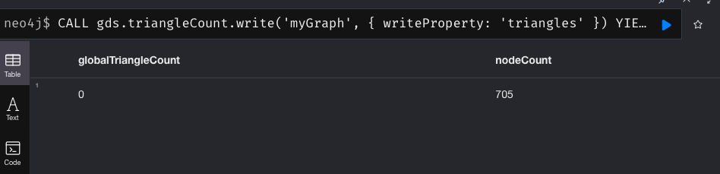
Neo4j – triangular node
Triangular node among relationship – ACQUIRE
Triangle counting has gained popularity in social network analysis, where it is used to detect communities and measure the cohesiveness of those communities. It can also be used to determine the stability of a graph, and is often used as part of the computation of network indices, such as clustering coefficients

Slide 19
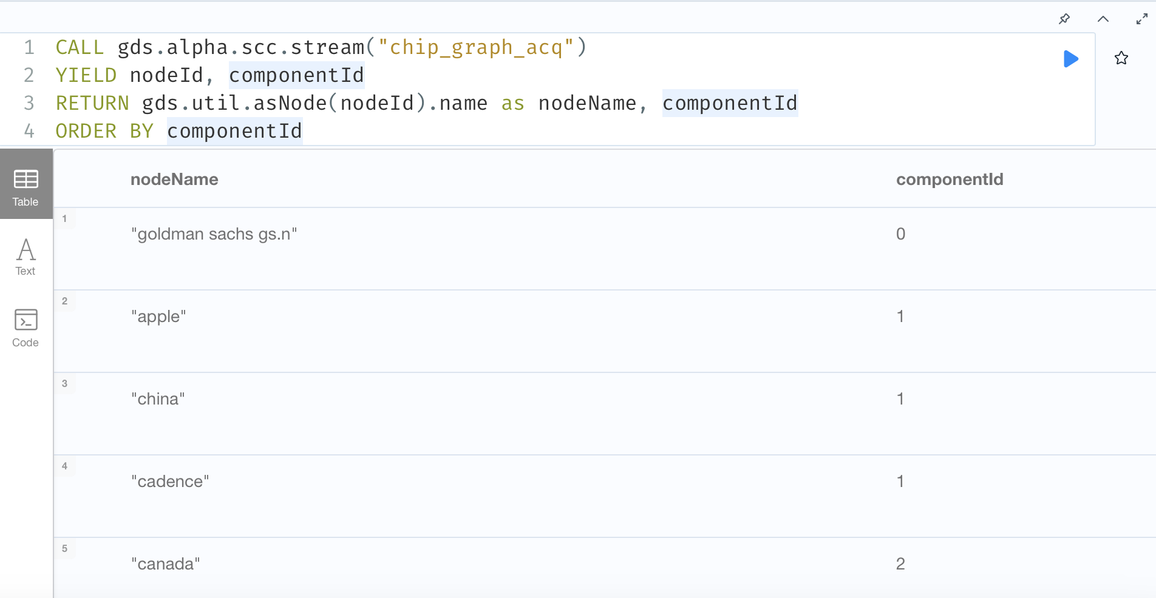
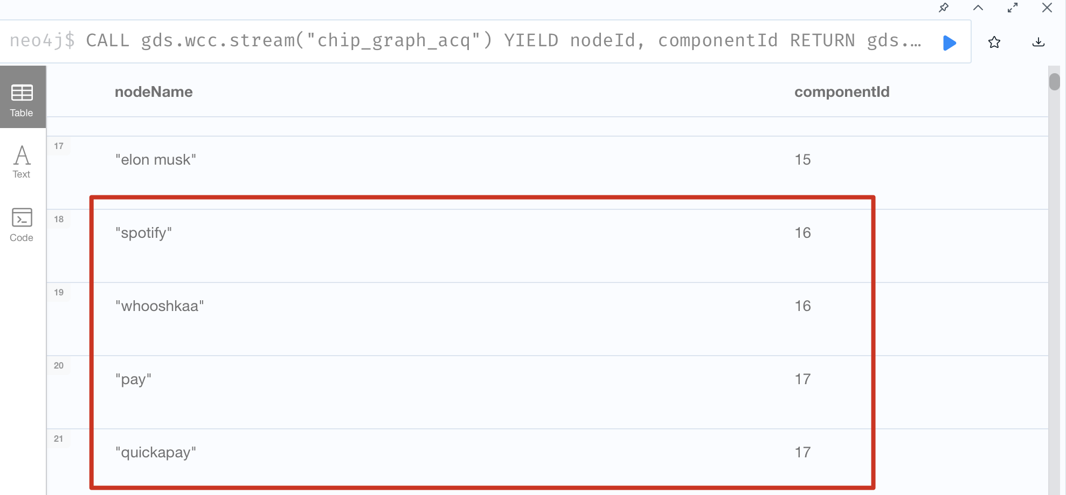
Gds graph – connection
CALL gds.graph.project.cypher(
‘chip_graph_acq',
'MATCH (n) RETURN id(n) AS id',
'MATCH (n)-[e:ACQUIRE]-(m) RETURN id(n) AS source, e AS edge, id(m) AS target’
)
W/SCC is often used early in an analysis to understand the structure of a graph. Using W/SCC to understand the graph structure enables running other algorithms independently on an identified cluster. As a preprocessing step for directed graphs, it helps quickly identify disconnected groups.

Slide 20

DEMO – neo4j

Slide 21
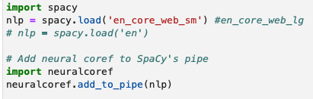
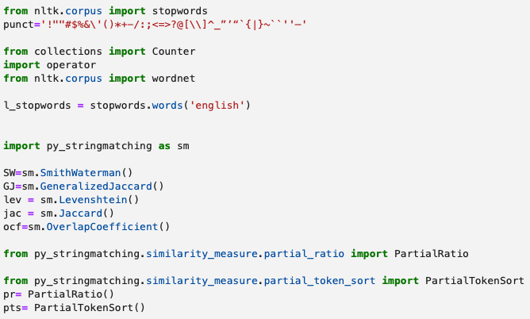
Tools used
Nltk
Spacy
spacy_wordnet.wordnet_annotator
py_stringmatching
Neuralcoref
Wikipediaapi
neo4j

Slide 22
Challenges lessons learned
S-V-O extraction was complicated
Filtering reduced data size because most of verb were stop-words
CPU processing power limited experimentation
Entity /label mismatch during s-v-o extraction
eg – Intel : GPE ; COVID19 - PERSON
Relationship clustering because Purchase/Buy/ Acquisition
Subject cleaning like tesla, tesla motors and tesla motors inc.
Analyzing China & role → cluster topics with semiconductor and covid

Slide 23

Thank You !

